Slide 1
Planning with Hierarchy and Abstraction
Tom Silver
Robot Planning Meets Machine Learning
Princeton University
Fall 2025

Slide 2
Let’s Play a Review Game
Bar trivia rules
Break up into teams of 3-5
Give your team a great name
I will ask questions
You will discuss quietly with your team
Write down your answer
Hold it up when I say so

Slide 3
Question 1
Goal
1 inch
What is the expected number of nodes that RRT will create in the example on the right?
Square Obstacle
Side Length: 2 inches
1 inch
Less than 5
Between 5 and 25
Between 25 and 100
Greater than 100 / no limit
1 inch
Robot
1 inch

Slide 4
Question 2
Consider a POMDP with 2 states, 2 observations, and 2 actions.
Suppose that our initial belief state is uniform.
Is it possible that the corresponding Belief MDP has an infinite number of reachable states?

Slide 5
Question 3
True or False: if a POMDP has a deterministic transition distribution and a deterministic observation distribution, then there exists some policy for the agent that would lead to an absolutely certain belief state (some state has 100%).

Slide 6
Question 4
True or False: for any classical planning problem, if a solution exists, then a solution also exists in the delete relaxed problem.

Slide 7
Question 5
True or false: in classical planning, given an optimal heuristic, the number of nodes expanded by A* is equal to the number of actions in the output plan.

Slide 8
Question 6
Which of the following is true about MCTS, but not about RTDP?
Requires only simulator access to MDP
Focuses on “promising” parts of AODAG
Adds one new state node at each iteration
Backpropagates values after each iteration
Uses rollout heuristic to estimate leaf node values
Uses greedy policy to select nodes to expand
You may select multiple.

Slide 9
Question 7
Which of the following bandit exploration strategies are guaranteed to try all arms infinitely often in the limit?
Uniform random
Exploit only
Epsilon-greedy (for nontrivial epsilon)
UCB
You may select multiple.

Slide 10
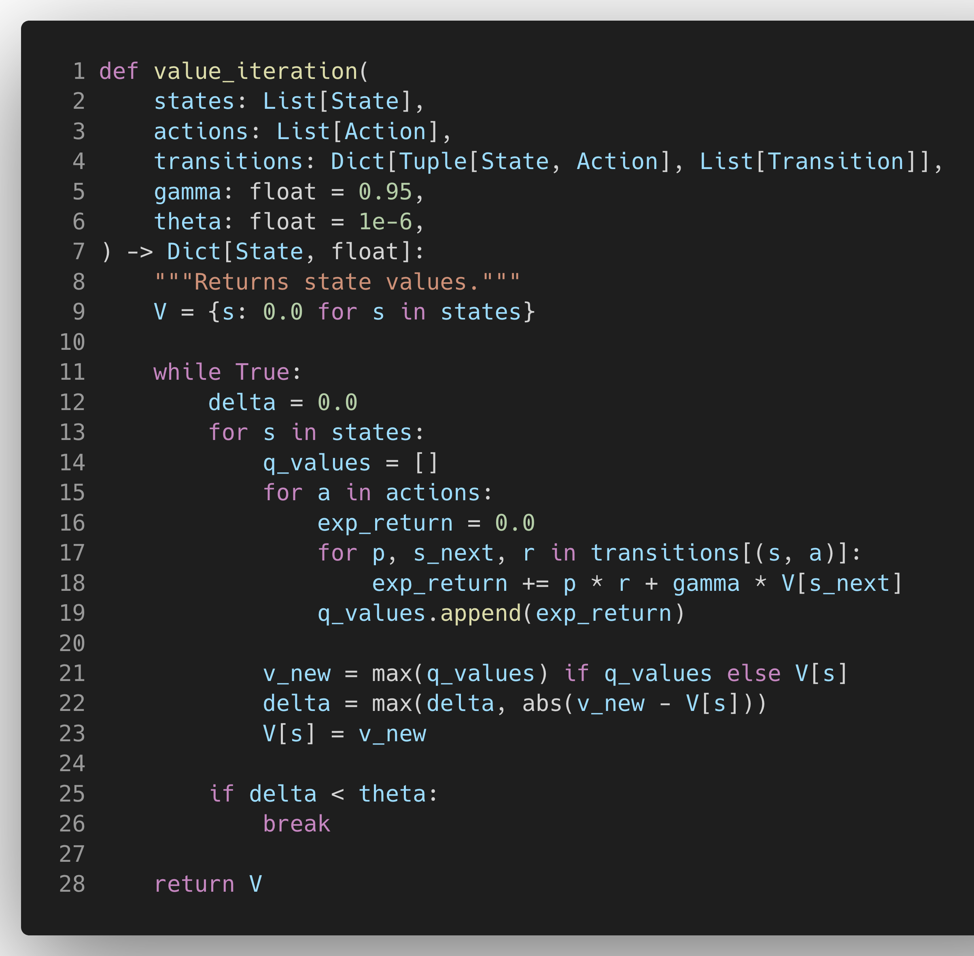
Question 8
Is there any bug in this code, and if so, which line?

Slide 11
Question 9
What are the three kinds of MDP time horizons?

Slide 12
Question 10 (Tiebreak)
List any algorithms we have covered in this course. The most recalled wins.

Slide 13
Planning with Hierarchy and Abstraction
Tom Silver
Robot Planning Meets Machine Learning
Princeton University
Fall 2025

Slide 14
Recap and Preview
Last time: planning in continuous state and action spaces
This time: same problem setting, new tools: abstractions!

Slide 15
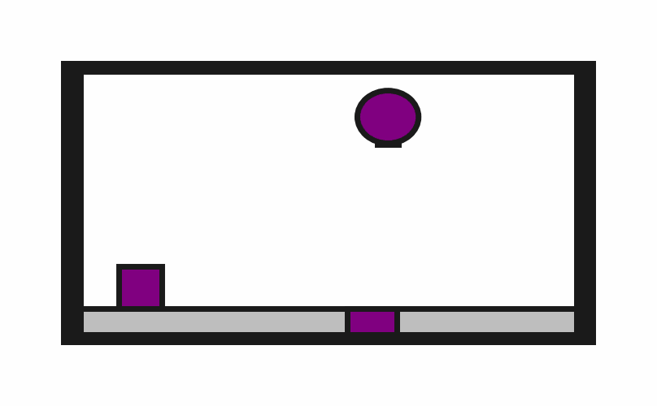
Human Demo

Slide 16
Random Actions

Slide 17
Task Distribution

Slide 18
Example
Which planners could we try? Would they work?
State space: Robot config, block pose (8D)
Action space: Pose change, vacuum (5D)
Transition function: Apply action but disallow collisions (no change)
Cost function: -1 until block on target

Slide 19
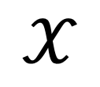
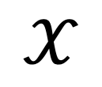
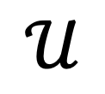
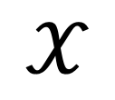
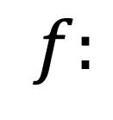
A Two-Level Hierarchy
Low-level transition model
Low-level action space
Low-level state space
$$f:$$
$$𝒳$$
$$𝒰$$
$$𝒳$$
$$𝒰$$
$$𝒳$$

Slide 20
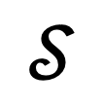
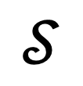


A Two-Level Hierarchy
$$𝒮$$
$$𝒮$$
Abstract state space
$$Ψ$$
$$Ψ$$
State abstraction models
$$f:$$
$$𝒳$$
$$𝒰$$
$$𝒳$$
$$𝒰$$
$$𝒳$$
Low-level state space

Slide 21
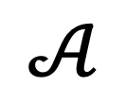
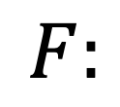
A Two-Level Hierarchy
$$F:$$
$$𝒮$$
$$𝒜$$
$$𝒮$$
Abstract state space
$$Ψ$$
$$Ψ$$
Abstract action space
Abstract transition model
$$f:$$
$$𝒳$$
$$𝒰$$
$$𝒳$$
$$𝒰$$
$$𝒳$$

Slide 22

A Two-Level Hierarchy
$$F:$$
$$𝒮$$
$$𝒜$$
$$𝒮$$
Abstract action space
$$Ψ$$
$$Π$$
$$Ψ$$
Action abstraction models
$$f:$$
$$𝒳$$
$$𝒰$$
$$𝒳$$
$$𝒰$$
$$𝒳$$

Slide 23
A Two-Level Hierarchy
$$F:$$
$$𝒮$$
$$𝒜$$
$$𝒮$$
Maybe it’s easier to plan up here!
$$Ψ$$
$$Π$$
$$Ψ$$
$$f:$$
$$𝒳$$
$$𝒰$$
$$𝒳$$
$$𝒰$$
$$𝒳$$

Slide 24
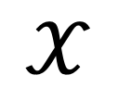
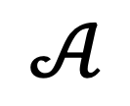
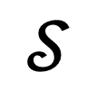


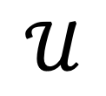
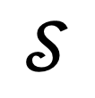
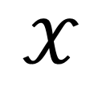
Abstractions in Example
HoldingBlock: bool BlockOnTarget: bool
“pick” “place”
$$𝒮$$
$$𝒜$$
$$𝒮$$
State abstraction
$$Ψ$$
$$Π$$
Action refinement
$$𝒳$$
$$𝒰$$
$$𝒳$$
$$𝒰$$
$$𝒳$$
Robot config, block pose
Pose change, vacuum (5D)

Slide 25
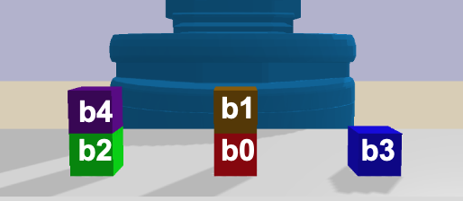
State Abstraction with Predicates
OnTable(b2), On(b4, b2) OnTable(b0), On(b1, b0)
OnTable(b3)
def classifyOnTable(state, ?block):
state[?block].z < 1e-5
def classifyOn(state, ?top, ?bot):
(state[?top].z – state[?bot].z – state[?bot].size) < 1e-5 & (state[?top].x – state[?bot].x) < 1e-5 &
(state[?top].y – state[?bot].y) < 1e-5 &
Abstract state
abstract
 | x | y | z | size
rob | 0.63 | 0.11 | 0.94 | 0.5
b0 | 0.74 | 0.11 | 0.00 | 0.1
b1 | 0.75 | 0.10 | 0.20 | 0.1
b2 | 0.50 | 0.11 | 0.00 | 0.1
b3 | 0.99 | 0.12 | 0.00 | 0.1
b4 | 0.51 | 0.11 | 0.20 | 0.1
State

Slide 26
Operators as Abstract Actions
Operator-PickFromTable:
Arguments: [?b - block, ?r - robot]
Preconditions: {GripperOpen(?r), OnTable(?b)}
Add effects: {Holding(?b)}
Delete effects: {GripperOpen(?r), OnTable(?b)}
Arguments
List of typed variables
Preconditions
What must be true in order to use this operator?
Add/Delete Effects
How is the abstract state changed by this operator?

Slide 27
An Abstract Transition Model
PickFromTable(b1, rob)
Abstract state s₁
Abstract state s₀
PickFromTable(b2, rob)
Abstract state s₂
Unstack(b3, b4, rob)
Abstract state s₃
An abstract (partial) transition model

Slide 28
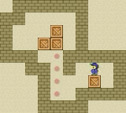
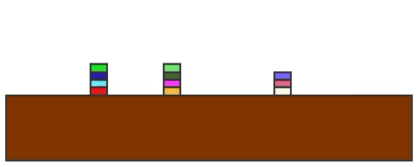
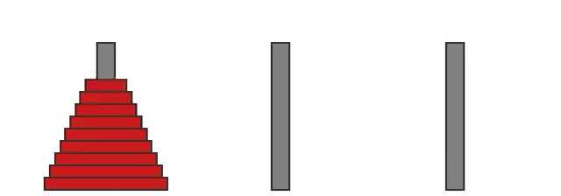
Why Predicates and Operators?
If we have predicates and operators, then we can use very powerful off-the-shelf symbolic planners!
Blocks World
Plan length: 28
Planning time: 0.12 s
Sokoban
Plan length: 167
Planning time: 0.25 s
Hanoi
Plan length: 579
Planning time: 0.22 s
Planning with Fast Downward (https://www.fast-downward.org)
Rendering and simulation with PDDLGym (https://github.com/tomsilver/pddlgym)

Slide 29
$$F:$$
$$𝒮$$
$$𝒜$$
$$𝒮$$
$$Ψ$$
$$Π$$
$$Ψ$$
$$f:$$
$$𝒳$$
$$𝒰$$
$$𝒳$$
$$𝒰$$
$$𝒳$$

Slide 30
Policies as Abstract Action Models
State
Policy
Action
def policyPickFromTable(state, ?b, ?r):
dx = (state[?b].x - state[?r].x)
dy = (state[?b].y - state[?r].y)
dz = (state[?b].z - state[?r].z)
return [dx, dy, dz]
Parameters
Same as operator
Simplified example
The policy should achieve the operator effects when the operator preconditions hold

Slide 31
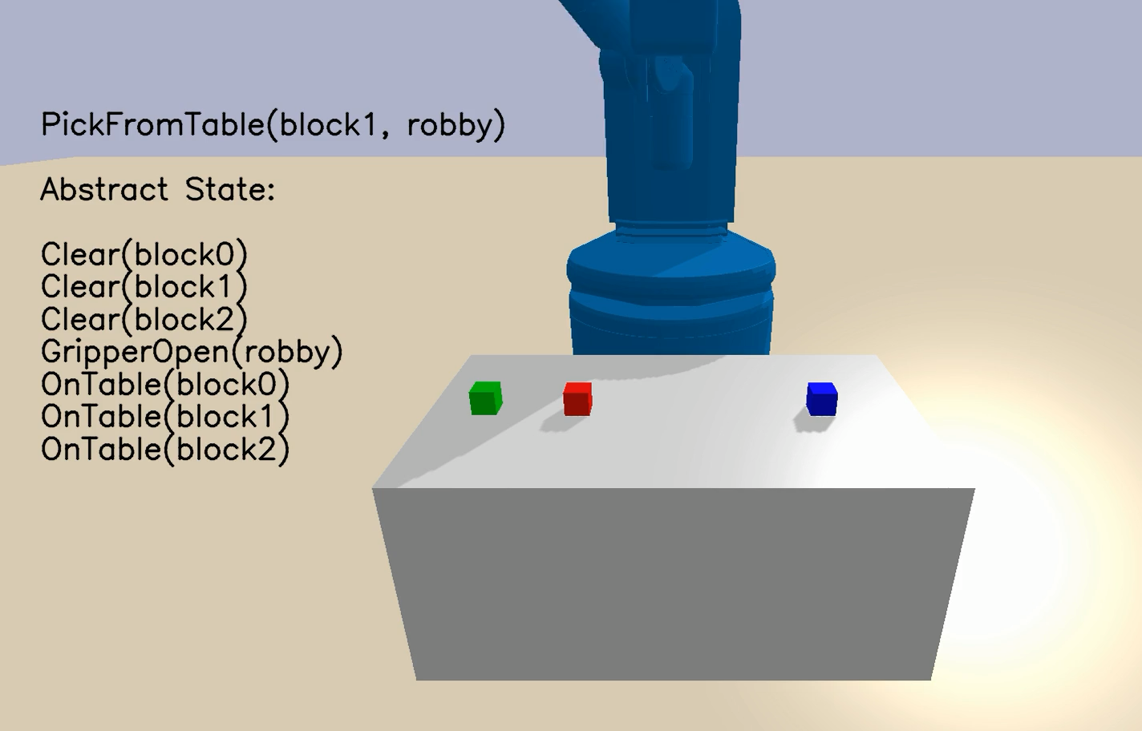

Example Policy Executions

Slide 32
Skills: abstract actions that bring the robot from one abstract state to another
What abstract state transition?
How should I get there?
A skill has an operator and a policy

Slide 33
Classical Planner
Goal g
Skills
Abstract state s₀
Skill a₁
s₁
Skill a₂
…
Predicates
abstract
abstract
Initial state x₀
u₁
f
x₁
u₂
f
x₂
u₃
f
x₃
u₄
f
x₄
…
Action abstraction
via skills

Slide 34
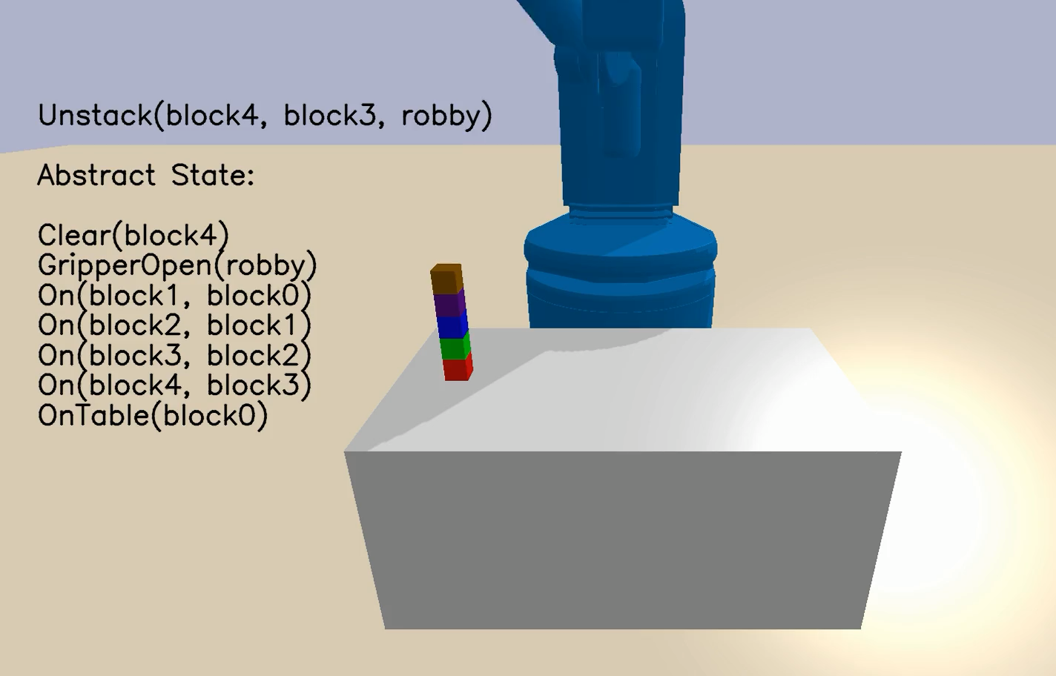
Goal

Slide 35
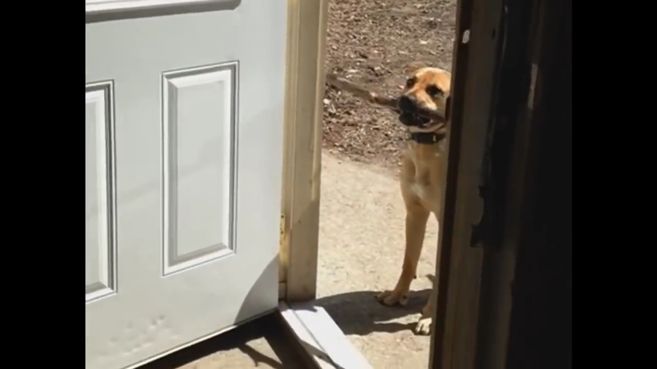
The abstractions might be liars…

Slide 36
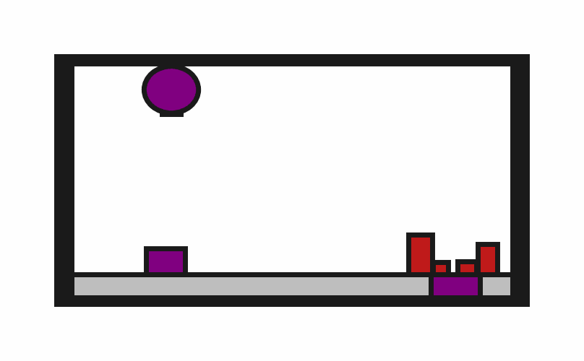

Slide 37
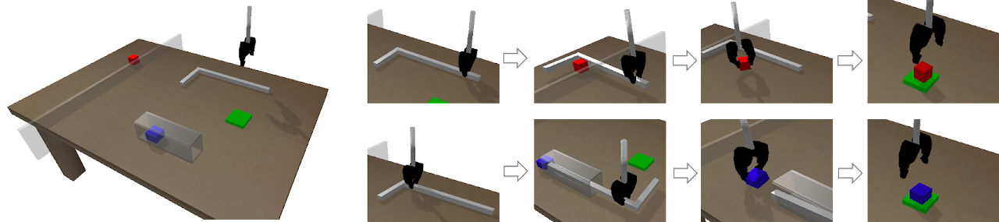
“Deep Affordance Foresight: Planning Through What Can Be Done in the Future.” Danfei Xu, Ajay Mandlekar, Roberto Martin-Martin , Yuke Zhu, Silvio Savarese and Li Fei-Fei. ICRA 2021.

Slide 38
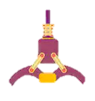


Operator-PushOutOfTube:
Arguments: [ , , ]
Preconditions: {Holding( , ), InTube(. )}
Add effects: {OutOfTube( )
Delete effects: {InTube( )}

Slide 39
Possible Conclusions from this Example
Insufficient predicates → learn new predicates HoldingBottom, HoldingTop, etc.
Insufficient policies → learn better policies Put down the tool and regrasp if needed
Insufficient planner → be less trusting of the abstractions View abstractions as guidance for low-level planning

Slide 40
Bilevel Planning: View Abstractions as Constraints
Symbolic Planner
Goal g
Abstract state s₀
Abstract state s₁
Abstract state s₂
…
Find states x₀, x₁, x₂, … and actions u₁, u₂, … so that
abstract(x_{i} ) = s_{i+k} [abstract states are followed]
f(x_{i-1}, u_{i} ) = x_{i} [transitions are valid]
Predicates
abstract
Initial state x₀

Slide 41
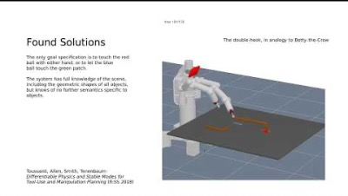
Logic-Geometric Programming
Toussaint (2015)

Slide 42
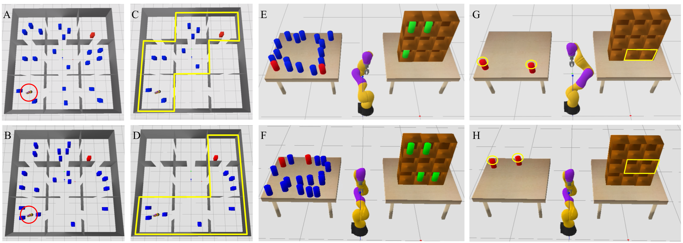
Side Note: Constraints Can Help Planning in Multiple Ways
From Chitnis*, Silver*, et al. (2020)

Slide 43
Logic-Geometric Programming
Toussaint (2015)
Possible issues:
Optimizing in low-level state and action space remains hard for long-horizon problems

Slide 44
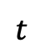
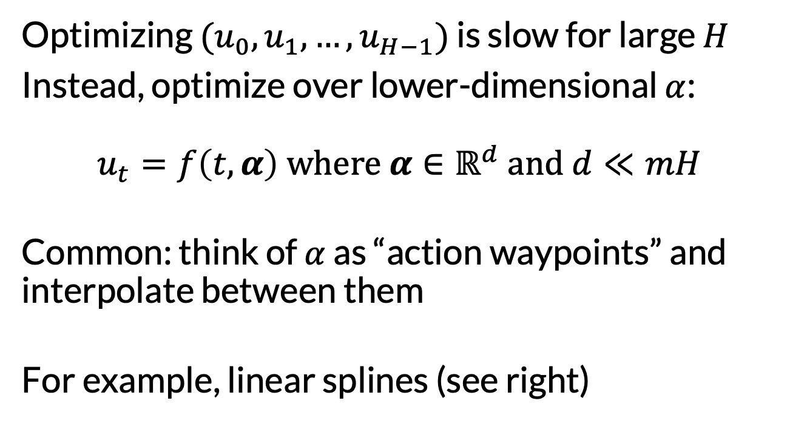
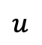
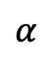
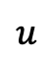
General Trick 2: Optimize Splines Instead
Recall from last lecture
Optimizing $(u_{0}, u_{1}, …,u_{H−1})$ is slow for large $H$
Instead, optimize over lower-dimensional $α$: $$u_{t}=f\left(t, α\right) where α∈ℝ^{d} and d≪mH$$
Common: think of $α$ as “action waypoints” and interpolate between them
For example, linear splines (see right)
$$u$$
$$α$$
$$u$$
$$t$$

Slide 45
Parameterized Skill Policies
Different Parameters
Operator-PickTool:
Arguments: [ , ]
Preconditions: {GripperOpen( )}
Add effects: {Holding( , )
Delete effects: {GripperOpen( )}

Slide 46
Symbolic Planner
Goal g
Skills
Abstract state s₀
PickTool
s₁
PushOutOfTube
…
Sampler
Parameter θ
Predicates
abstract
abs
Policy
Initial state x₀
u₁
f
x₁
u₂
f
x₂
u₃
f
x₃

Slide 47
Symbolic Planner
Goal g
Skills
Abstract state s₀
PickTool
s₁
PushOutOfTube
…
Sampler
Parameter θ’
Predicates
abstract
abs
Policy
Initial state x₀
u₁
f
x₁
u₂
f
x₂
u₃
f
x₃

Slide 48
Logic-Geometric Programming
Toussaint (2015)
Possible issues:
Optimizing in low-level state and action space remains hard for long-horizon problems
We still may have “contract disputes”…

Slide 49
The abstractions may be pathological liars…
An abstract plan may not be refinable at all!

Slide 50
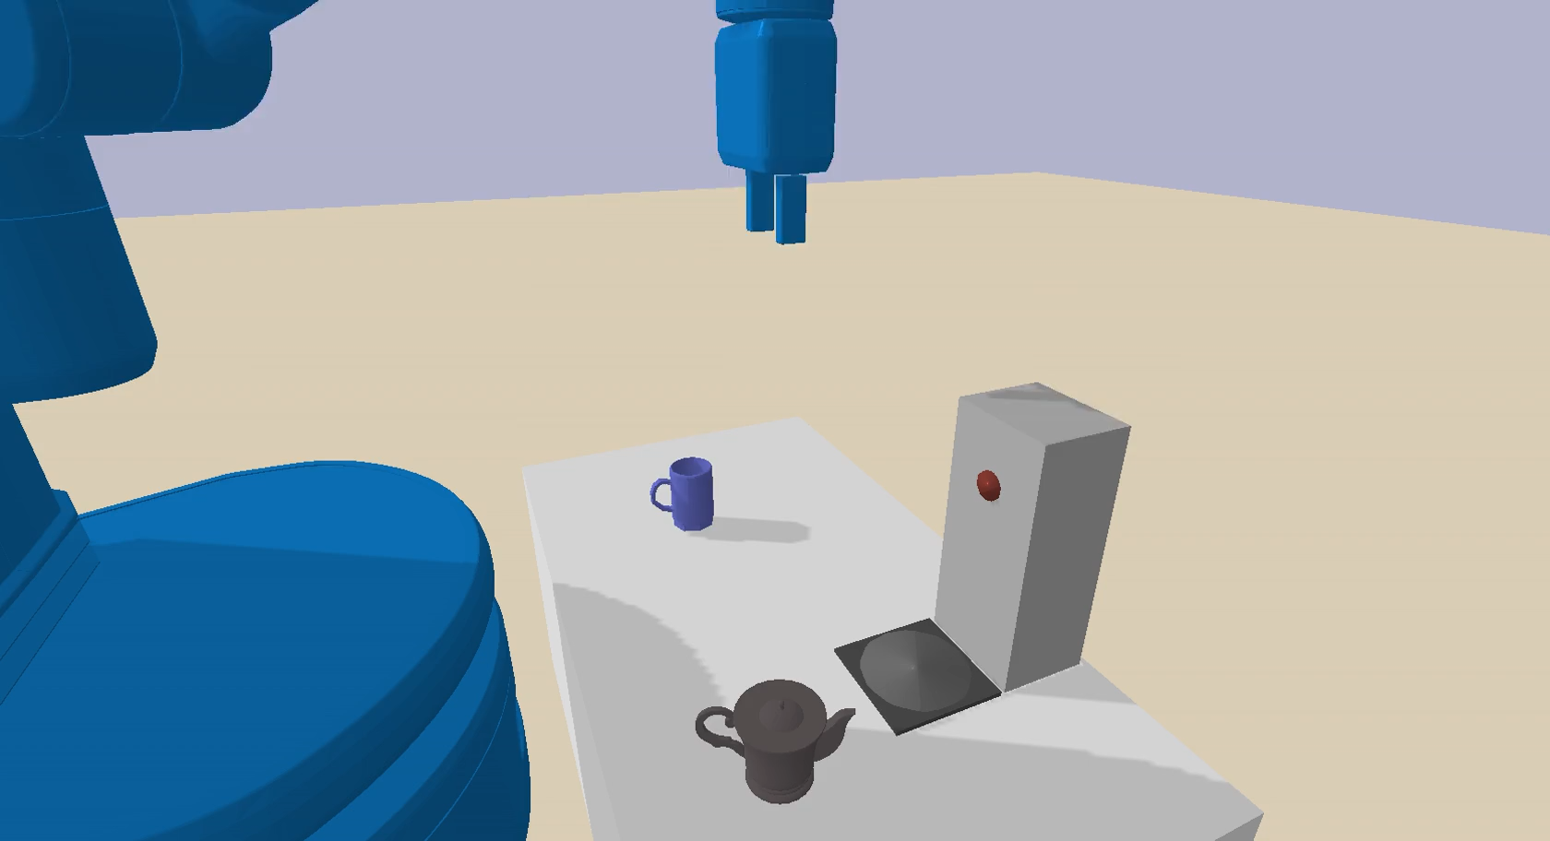
Coffee Domain
Abstract Plan
Grasp handle
Place on plate
Turn plate on
Pick up pot
Pour into cup

Slide 51
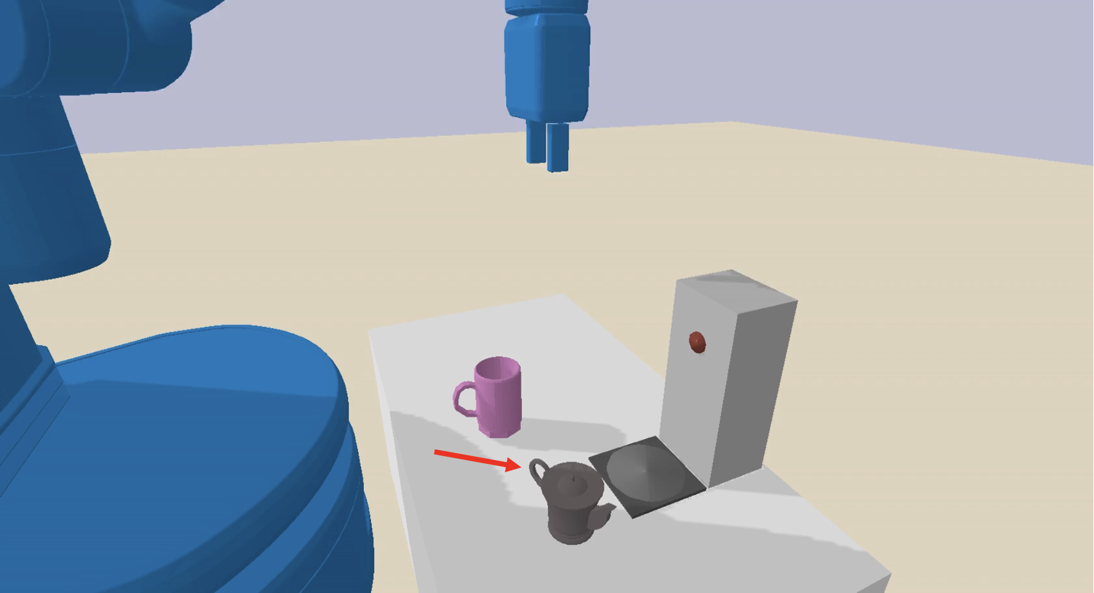
Coffee Domain
We need a different abstract plan!
Abstract Plan
Grasp handle
Place on plate
Turn plate on
Pick up pot
Pour into cup

Slide 52
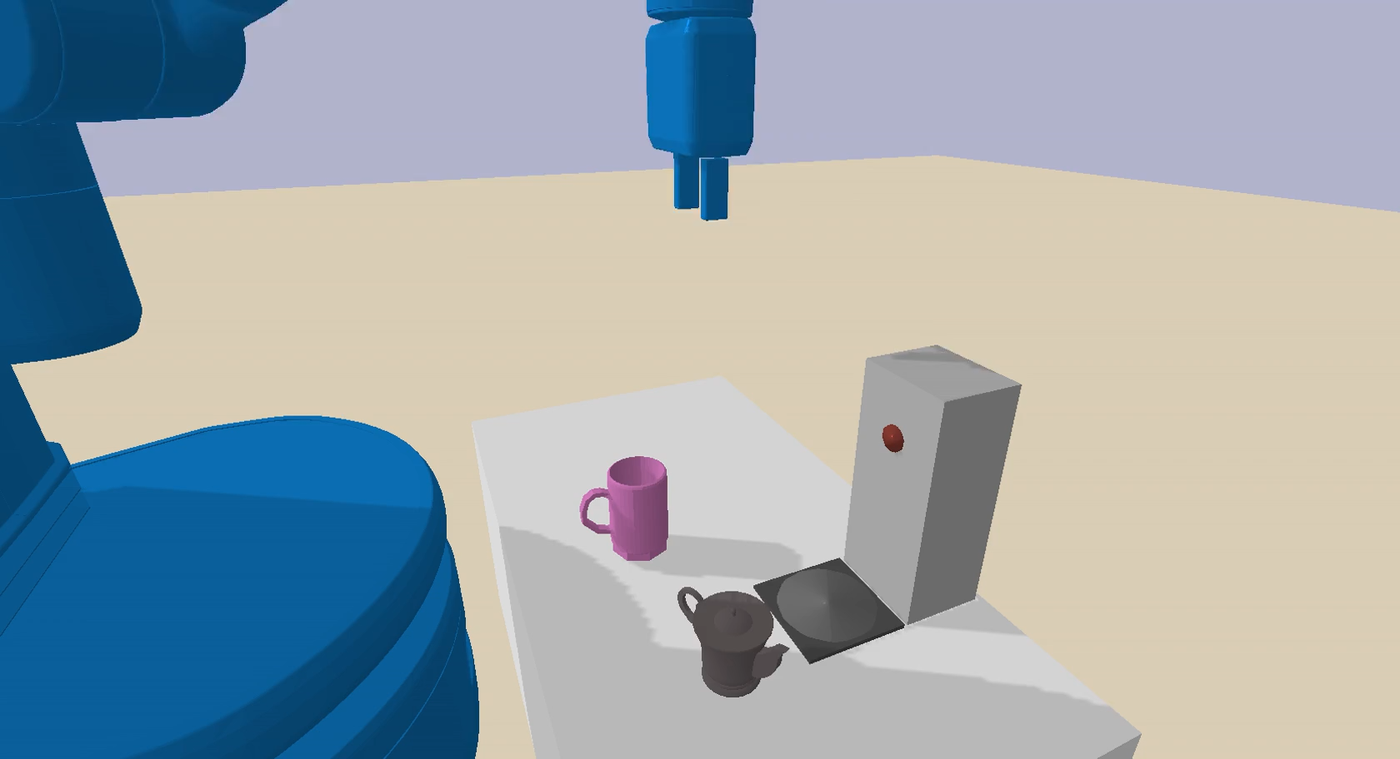
Coffee Domain
Abstract Plan
Rotate pot
Grasp handle
Place on plate
Turn plate on
Pick up pot
Pour into cup

Slide 53
One Remedy: Try Multiple Abstract Plans
Symbolic Planner
Goal g
Abstract state s₀
Abstract state s₁
Abstract state s₂
…
Find states x₀, x₁, x₂, … and actions u₁, u₂, … so that
abstract(x_{i} ) = s_{i+k} [abstract states are followed]
f(x_{i-1}, u_{i} ) = x_{i} [transitions are valid]
Predicates
abstract
Initial state x₀

Slide 54
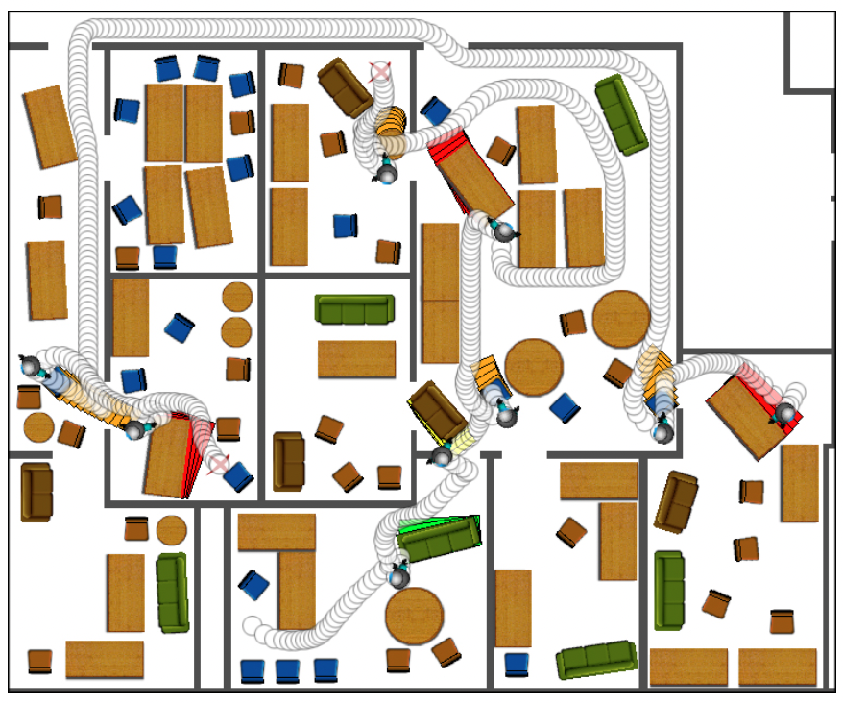
Better: Use Feedback from Refinement Failure to Influence Task Planning
Example: “Navigation Among Moveable Obstacles (NAMO)”
(Stilman & Kuffner 2004)
(Simplified explanation) When a collision is encountered during refinement, make a plan to move the collided object out of the way first

Slide 55
Another Approach: Sample then Search
Extends ideas from sample-based motion planning (RRT, PRM)
Instead of sampling just robot configurations, sample…
Candidate grasps
Candidate positions of objects
…
Sample in a factored and conditional way
Example: conditioned on a future object position, sample a grasp
Conditioned on a grasp, sample a robot base position
Can sample “forward”, “backward”, or any-which-way in time
See: PDDLStream (Garrett et al. 2018)

Slide 56
Summary: Task and Motion Planning (TAMP)
Plan with state and action abstractions
Use relational abstractions (e.g., PDDL) when possible
Beware that the abstractions might be “liars”
TAMP is most interesting in this case!
Use the abstractions as “guidance” for planning
Closely related to hierarchical RL

